Slide 1
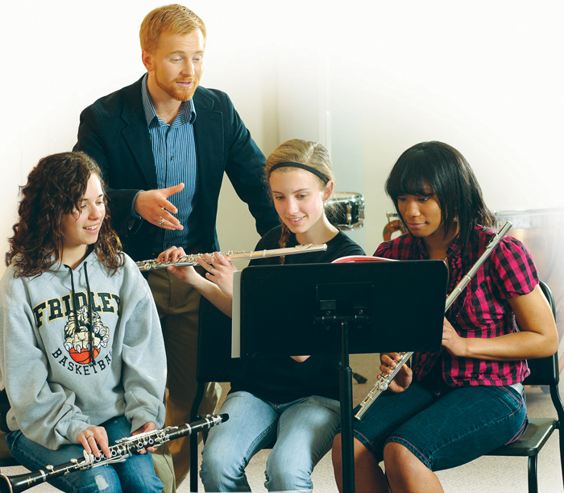
Welcome Parents!

Slide 2



Music and Brain Development
“Music produces profound, lasting changes in the brain.”
– Scientific American, November 2010
And neurologists have found that music instruction can impact a baby's brain more than any other activity.

Slide 3
Love of Music Creates
Life-long Success
﻿﻿﻿“We look for artists because those are the people who are going to fill 21st Century jobs . . . they have to know the science . . . but they have to go beyond the science to serve the customer.”
– Raymond Hartfield, AT&T
“Ah, music,” he said wiping his eyes. “A magic far beyond all we do here.”
– Albus Dumbledore, Harry Potter

Slide 4
Love of Music Creates
Life-long Success
﻿﻿﻿“Secondary students who participated in band or orchestra reported the lowest lifetime and current use of all substances (alcohol, tobacco, illicit drugs).”
– Texas Commission on Drug and Alcohol Abuse Report
“The life of the arts, far from being an interruption, a distraction in the life of a nation, is close to the center of a nation’s purpose—and is a test to the quality of a nation’s civilization.”
– John F. Kennedy

Slide 5
Love of Music Creates
Life-long Success
﻿﻿﻿“When I hear people asking how do we fix the education system, I tell them we need to do the opposite of . . . cutting budgets, by cutting music programs . . . Nothing could be stupider than removing the ability for the left and right brains to function.
Ask a CEO what they are looking for in an employee and they say they need people who understand teamwork, people who are disciplined, people who understand the big picture. You know what they need? They need musicians.”
– Former Arkansas Governor Mike Huckabee

Slide 6
The Value of Music Education
﻿﻿Young people who consistently participate in comprehensive, sequential, and rigorous arts programs are…

Slide 7
The Value of Music Education
﻿﻿﻿4x more likely to be recognized for academic achievement
3x more likely to be elected to class office at their schools
4x more likely to win an award for writing an essay
or poem
– Living the Arts through Language + Learning: A Report on Community based Youth Organizations, Shirley Brice Heath, Stanford University and Carnegie Foundation for the Advancement of Teaching, Americans for the Arts Monograph, November 1998

Slide 8
Leads to Success as an Adult
﻿﻿﻿﻿﻿﻿“Music is a magical gift we must nourish and cultivate in our children, especially now as scientific evidence proves that an education in the arts makes better math and science students...”
– Michael Green, Recording Academy President and CEO at the 42nd Annual Grammy Awards, February 2000

Slide 9
Leads to Success as an Adult
﻿﻿“The very best engineers and technical designers in the Silicon Valley industry are, nearly without exception, practicing musicians.”
– Grant Venerable, “The Paradox of the Silicon Savior,” as reported in “The Case for Sequential Music Education in the Core Curriculum of the Public Schools,” The Center for the Arts in the Basic Curriculum, New York, 1989

Slide 10
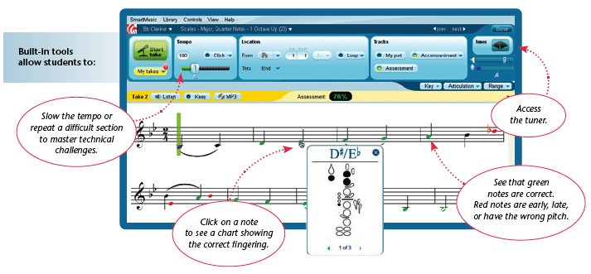
SmartMusic is Interactive Music Software
As music appears on-screen, students play along:

Slide 11
Students Learn Faster with SmartMusic
﻿An annual subscription provides your student with:
  Instant feedback to help them improve faster
  A way to practice with professional accompaniment
  Access to thousands of band, orchestra,
  and vocal pieces
  The means to record and listen to their performances to hear how they really sound

Slide 12

Students Learn Faster with SmartMusic
﻿﻿All for the price of one latté a month!
Getting started is easy

Slide 13

Thank you for your support of the school’s music program!

